Slide 1
Innovation in Health Insurance
Voice of customer
Anil Sharma

Slide 2
Market Position on Health Insurance
Growth of Health portfolio unprecedented .
Widening pool of members, homogenous risk group.
Reinsurers interest in market to stabilize the results.
Multiple products / Insurers to choose LSB category/ Management.
Highly dynamic and competitive market place. 62 Insurers, 26 TPAs.
High level of knowledge / expertise/ product development.
High claim ratio, prevalence of chronic conditions.
Disruption and AI finally lands in Insurance
Growing interest among UAE residents to lead a healthier lifestyle.
Gym memberships and personal fitness training sessions on the rise.
Government Initiatives 30:30 Fitness challenge.
Medical providers / Insurers / Corporates supporting wellness initiatives .
Medical tourism- Dubai ranked on top in Arab World and 16 globally.

Slide 3
Components of Health Care Costs
Inpatient, Outpatient, Pharmacy, Diagnostics
Fixed deductible, Co- Pays, Annual Deductible.
Maximum Annual Coverage.
Geographical coverage –Worldwide including / Excluding USA/Canada.
Coverage for Dental or Optical.
Utilization patterns – prognosis, main surgeries.
Age of members.
Prevalence of chronic conditions.
Medical inflation.
Alternative treatment.
Visa issuing Emirates- DHA, MOH plan and…more to come.
Approved Insurer / Intermediary
Approved Network
Regulatory compliance for plan & benefits.
Re( insurance ) support.
Use of sophisticated medical equipment's.
Demand supply imbalance – demand for healthcare outpacing the supply of resources.
Advances in medical science.

Slide 4
Health Insurance Infrastructure
Medical Industry
Health care providers
Technology and operations
Third party Administrators
Users
Professionals
Regulators
(Re) Insurers
Highly complex with multiple entities many times working toward conflicting interest / goals.

Slide 5
Health Insurance Rising Health Care Costs Ecosystem
Health care costs started to creep around 2010-11 onwards.
Top risk feared as premiums keep on rising and disrupts budgets.
Responding to rising health care costs by adjusting deductibles. Co-pays, cadre based grouping in non compulsory category of employees.
All stakeholders need to make more efforts to respond to challenges
Business now started having forward thinking plan.
High costs are for surgeries.
Costs have exceeded by more than 2-3 times of annual general inflation rate
Alternative Insurers / Mapping for Network with locations.
People / insurers are at times tactical/ short sighted.

Slide 6
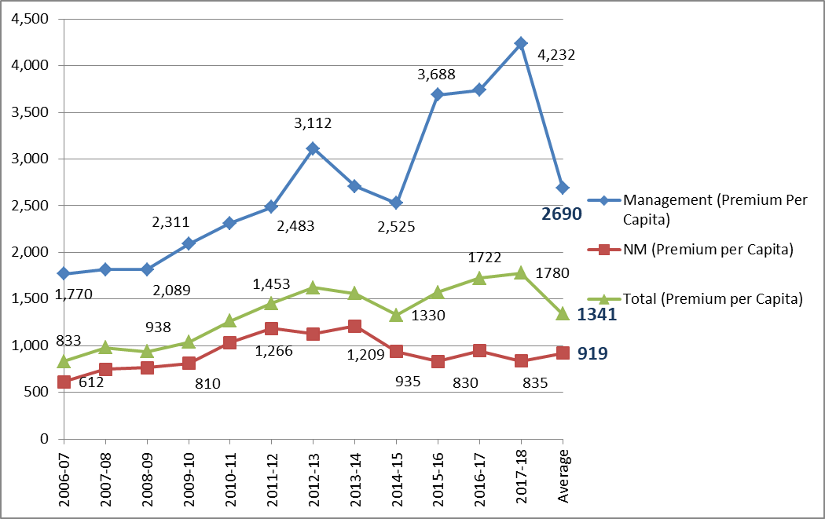
Per Capita Premium 2006-07 to 2017-18
Year | Management (Premium Per Capita) | NM (Premium per Capita) | Total (Premium per Capita)
2006-07 | 1,770 | 612 | 833
2007-08 | 1,815 | 748 | 979
2008-09 | 1,815 | 765 | 938
2009-10 | 2,089 | 810 | 1038
2010-11 | 2,311 | 1,033 | 1,266
2011-12 | 2,483 | 1,185 | 1,453
2012-13 | 3,112 | 1,128 | 1,623
2013-14 | 2,706 | 1,209 | 1,559
2014-15 | 2,525 | 935 | 1330
2015-16 | 3,688 | 830 | 1574
2016-17 | 3,738 | 944 | 1722
2017-18 | 4,232 | 835 | 1780
Premium increased by 2.39 times ( Management) and 1.36 times for Non Management
3

Slide 7

Premium 2013-14 to 2017-18
156% Average increase in health care cost in 5 year- Management schemes

Slide 8
Prognosis Of Morbid Conditions -Reasons
Break up of Diagnosis
Diagnosis | No. Of Cases | Main Factor | Contributing Causes
Upper Respiratory | 2,045 | Life Style/OH | Smoking(A/P), Exposure to cold air, Oral Hygiene, Dust
Injuries | 1,278 | Life Style | Insufficient warm up/stretching, contact sports
Diabetes | 545 | Life Style | Sedentary lifestyle, lack of walking/exercise
Gastritis | 635 | Life Style | Medications esp AID , Acidic food,meal timings
Hypertension | 423 | Life Style | Anxiety, Stress
Oncology | 50 | Life Style/BBL | Smoking(A/P), Diet, Red meat, carcinogenic, alcohol
Nephrolithiasis | 200 | Diet / Life style | Insufficient water intake, Lack of vegetable/fruits
Heart | 476 | Life Style | Cholesterol, lack of exercise , dietary imbalance
Abdominal | 182 | BBL | Appendicitis mainly, dietary
Fever | 306 | Hygiene | Viral, Bacterial, Hygiene, Environmental
Urinary Tract Infect. | 192 | Life Style | Low water intake, Toxic food, Unclean restrooms
Dermatology | 307 | Hygiene | Insects, hygiene , Sun exposure.
Eye | 210 | Life style | Looking at Computer, Mobile etc., (No short breaks)
Vitamin Deficiency | 144 | Life Style | Imbalanced meals
Gynaecology | 68 | Maternity | Maternity
Hypo/Hyper Thyroid | 119 | Life Style | Lack of exercise, imbalanced diet
Arthiritis | 83 | Life Style | Lack of exercise
EAR | 93 | Noise | Exposure to long hours of noise
Orthopedic | 25 | Life Style | Lack of calcium intake, weak bones
Allergy | 29 | BBL | Biological Bad Luck
Septic Shock (MODS) | 1 | Life Style | Combination of life style , dietary habits
Pilonidal Sinus | 1 | BBL | Biological Bad Luck
Hernia | 2 | BBL | Biological Bad Luck
Others | 600 | Multiple
Total | 8,014
Life Style (75%) | 6,015 | Smoking, Sedentary Lifestyle, Eating habits, Lack of exercise
Other (25%) | 1,999 | Noise exposure, Insufficient water intake, Lack of hygiene, BBL Allergy, Gynecology
Abbr: BBL -Biological Bad Luck; OH- Oral Hygiene, AID-Anti Inflam. Drugs, A/P - Active / Passive

Slide 9
Key Cost Drivers
Prevalence of chronic disease
Advancement In Medical Care
Visiting Hospitals for Outpatient
10-12% Medical Inflation in region
Changing regulatory environment
Primary care facilities
KEY COST DRIVERS
2/3 of total medical claims comes from Outpatient and 1/3 from Inpatient claims

Slide 10






Increase in Health Care Costs
.
.
.
.
.
Hospitalization
Cost of Procedures
Surgeries
Needless consultation with specialist
Over Prescription / cautious treatment
Medical test requirements

Slide 11
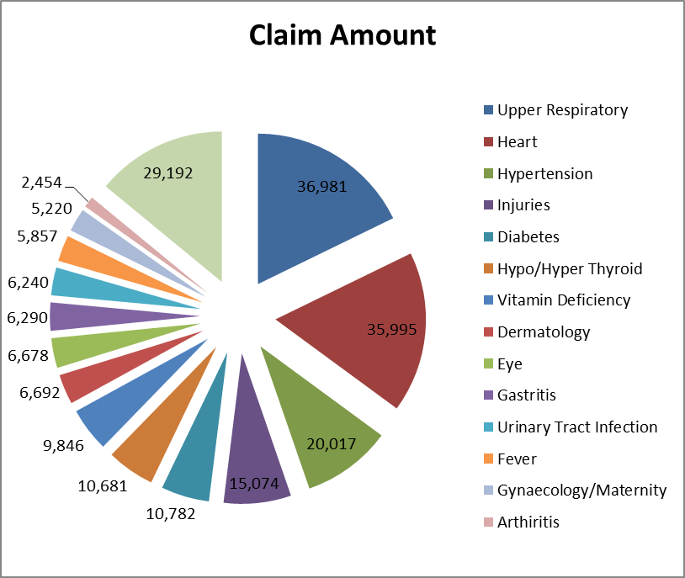
Major Prognosis of a Homogeneous Group

Slide 12
Claim Profiles
Gastritis, GERD, Digestive upsets/ lapses
Surgeries, Heart, orthopedic-knee, cancer, abdomen
Injuries –sports, musculoskeletal/ back
Chronic conditions, Diabetes, HBP, Thyroids Impaired lipids
Infections- upper respiratory, dominance of season’s flu, common cold
Maternity
Health care costs are skyrocketing due to the prevalence of chronic conditions such as cardiovascular disease, diabetes.
The health care system is to transition from a focus on the treatment of illness to an increasing emphasis on wellness and prevention.
2/3 of total medical claims comes from Outpatient and 1/3 from Inpatient claims.

Slide 13
CLAIM Distribution
POLICY | In-Patient | Out-Patient | Pharmacy | Total
Total | (25%) | (40%) | (35%) | (100%)
Pharmacy
In-Patient
Out-Patient

Slide 14
Leading condition for regions
MENA | APAC | Europe | LATAM
High Blood Pressure | Cancer/Tumor growth | Cardiovascular | Cancer/ Tumor Growth
Diabetes | Cardiovascular | Cancer/Tumor Growth | Diabetes
Respiratory | Gastrointestinal | High Blood Pressure | Cardiovascular
Cardiovascular | Respiratory | Musculoskeletal/Back | High Blood Pressure
Cancer/Tumor growth | Musculoskeletal/Back | Diabetes | Musculoskeletal
UAE Government statistics placed cancer as the third biggest risk in UAE after CVD and Road accidents.
Around 4,500 persons diagnosed every year. Any firm with 2000 workers can expect one per year to be diagnosed as cancer. 5 most common cancers were breast, thyroid, colorectal, leukemia and cervix -55% (Abu Dhabi 2014)
Source: AON

Slide 15
Indicated Risk Factors for future adverse claims
MENA | APAC | Europe | LATAM
High Blood Pressure | High Blood Pressure | High Blood Pressure | High Blood Pressure
Physical Inactivity | Obesity | Poor Stress Management | Bad Nutrition
Bad Nutrition | Physical Inactivity | Smoking | High Cholesterol
High Cholesterol | High Cholesterol | Obesity | Obesity
Poor Stress Management | Bad Nutrition | Physical Inactivity | Physical Inactivity
Source: 2018 Global Medical Trend Rates -AON

Slide 16
Cost mitigation methods most commonly reported
by geographic regions’
MENA | APAC | Europe | LATAM
Wellness Initiative | Cost containment | Cost containment | Wellness Initiative
Cost Containment | Wellness initiatives | Wellness Initiative | Cost Containment
Access and delivery restrictions | Access and delivery restrictions | Provider Network | Access and delivery restrictions
Plan design changes | Plan design changes | Plan design changes | Provider Networks
Flexible Benefits Plans | Flexible Benefits Plans | Flexible benefit plans | Plan Design changes
Cutting back on a crucial benefit is likely to demotivate staff and prompt them to look for
Opportunities elsewhere. Also a risk that health may suffer which may impact productivity.
Source: AON

Slide 17
Cost containment initiatives
Generic drugs
Do not use Hospital as a primary care.(OP)
Visit your GP first before visiting specialist .
Virtual consultation with qualified doctor over phone/ video.
Make use of wellness training.

Slide 18
Other challenges
Doctors usually prescribe the expensive treatment , which may not always appropriate.
Shop floor absenteeism.
There is a global waste and abuse. The problem appears to be systematic as in some cases people are offered certain diagnostics to avoid risk or maximize profits.
Software & latest technology using AI model is available which is supporting insurers to spot inconsistent prescriptions / approve treatment protocols specific to morbid condition.
“Mystery shopping campaigns” could be another way to check the abuse.
“AI” model built into the claim system recognize pattern of prescription and raise a red flag when a doctor delivers an abnormal course of treatment.(PBM)

Slide 19
Design and implementation of Medical Insurance and Wellness plans
Optimal beneficial scheme, driven by corporate philosophy , employee expectation , health risk profile, budgeted premium costs by :
  Data analysis for predictable claim patterns
  Understanding factors driving medical costs increases
  Premium technically required to address projected claims / price inflation
Devise / reorient wellness and cost-containment initiatives
Appraisal of cover/ network suitability
Which will lead to :
  Better management of health risks
  Higher employee motivation
  Engagement and productivity.

Slide 20
Adult Population..
OBESITY
DIABETES
HYPERTENSION
CORONARY HEART DISEASE
Reducing overall Lifespan by 10-13 years !

Slide 21




Fundamentals of Lifestyle
Nutrition---------------
Behaviour--------------
Conduct----------------
Thinking-----------------
Notes:
All of them have deteriorated these days.

Slide 22
Healthy ways of Living
DIET
PHYSICAL ACTIVITY
RELIEF OF STRESS
PERIODIC HEALTH CHECK-UPS
ADULT VACCINATIONS

Slide 23

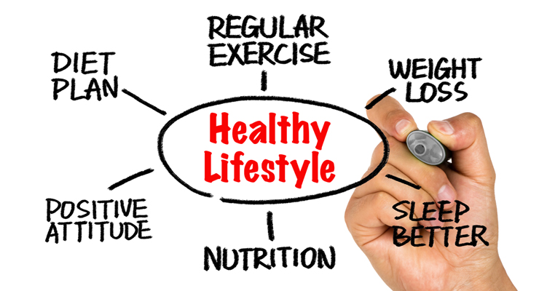
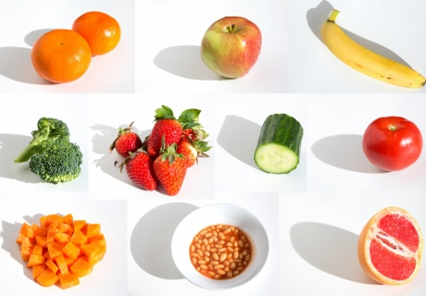
Tripod of Healthy Life Style
1. Dietary: Balanced diet. Five portions of fruits ,vegetables, salads pulses and beans
juices and smoothies in a day. Complex carb is best rather than soft carb.
2.Exercise: 150 minutes for 19 to 64 years in a week ( 30 minutes daily)
and 60 minutes daily for 5-18 years. 180 minutes daily for children below 5 .
3.No smoking.

Slide 24
Some observations
Global surveys indicate only 6% of the population is following the tripod of healthy life style advice .
Regular exercise can reduce the risk of developing upto 20 different illnesses like:
35% lower risk for coronary heart disease and stroke
50% lower risk of type 2 diabetes.
30% lower risk of cancer.
83 % lower risk of osteoarthritis.
Relieves stress, depression and anxiety
Better sleep.

Slide 25
Mitigation Initiatives to Control Medical Plan Cost Escalation
Objective would be to shift employee benefit from treatment to prevention to have sustainable scheme on continuous basis.
Wellness initiatives
  Health talks emphasizing on diet , exercise, life style modifications.
  Bringing third party vendors for on site health screening
  On line tools / mobile applications.
  Employee Orientation – with pathway to care
Cost Containment
  Generic drugs
  Encouraging employees to visit clinics for outpatient conditions than hospitals.
  Access and Delivery Restrictions

Slide 26
Month | Proposed Wellness Calendar 2018-19
Oct-18 | Orientation session / Breast cancer awareness session.
Nov-18 | In line with World Diabetes month, plan to arrange education and awareness seminar at various unit premises on Diabetes management programs.
Nov-18 | Health talks on prevention of cardiovascular diseases, improving lipid profiles with change in Dietary intakes, Omega 3 fatty acids found in Salmon, Sardines, herring, flax seeds and walnuts and adding up fruits, vegetables, whole grain and reducing consumption of unhealthy and processed food.
Dec-18 | Basic health check up through partnered medical provider.
Jan-19 | Talk on Importance of Nutrition - Improving dietary regimen.
Feb-19 | Cancer awareness programme. Speakers to be arranged from renowned medical providers to educate members on the causes of cancer and how can they avoid it.
Mar-19 | Employee orientation refresher on the policy coverage combining the orientation with education on the pathway to care. This would help members to change their behavior to have sustainable scheme.
Apr-19 | Ergonomics awareness- lower back pain, neck and shoulders.
May-19 | Adhoc wellness programme if required.
Jun-19 | Vitamin D awareness. Impact of Vitamin D deficiency on their health.
Aug-19 | Flu Vaccination at minimum cost .
Other initiatives | In Chair Yoga exercises – posture to avoid injuries / muscle pain
 | Holistic wellness through Nutrition- frozen food, nutrition labels reading etc.
 | September – Family Health and Fitness Month
 | Alternative treatment - avoiding anti biotic , as they kill good bacteria . Pro-biotic diets to generate bacteria to keep you healthy.

Slide 27
Way forward: Health coaches
Wellness coaching : Smoking cessation, increased physical activity, eating well and general weight management. ( 9 out of 10 lung cancers are caused by smoking)
Health coaching: Use of evidence based skillful conversation, clinical strategies and interventions to actively and safely engage in health behavior change to better self manage their health, health risks and acute chronic health conditions resulting in optimal wellness, improved health outcomes, lowered health risks and decreased health care costs.
The need to rein in costs and keep employees healthy are primary drivers for companies to use health coaching as an employee benefit.

Slide 28


Slide 29
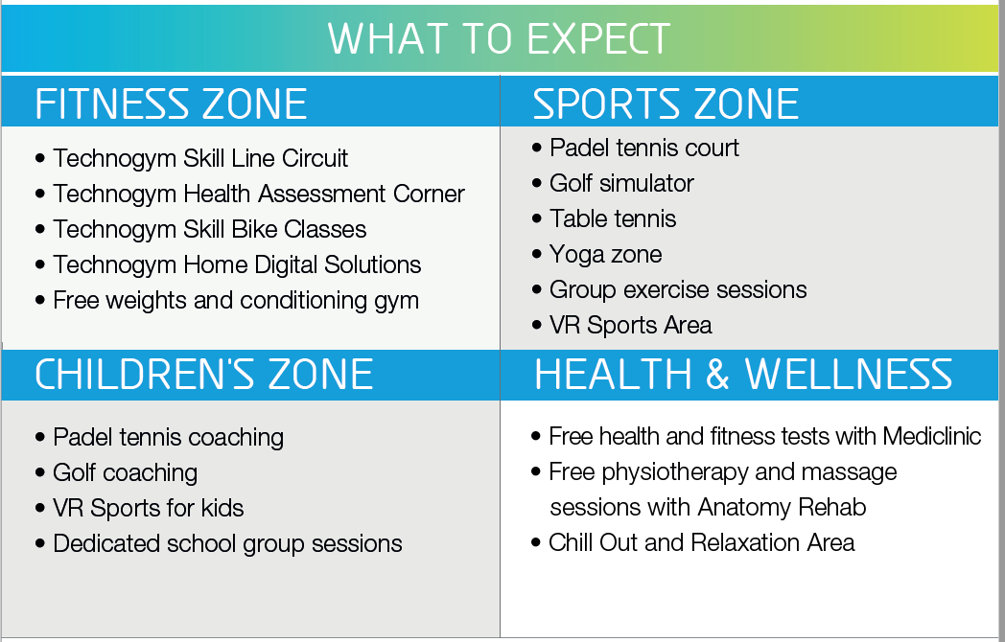

Slide 30
Data driven Underwriting
Intuition based underwriting or niche underwriting is no more relevant in the emerging era of big data with focus on coverage and tailor made products.
Digital and Technology critical paradox of efficient underwriting & claims management.
Data driven transformative business modelling and tools.
Product Innovation with technological experimentation
Break the fix model to predictive modelling:
Data analysis and AI can detect fraud quickly.
Endless potentials and possibilities.
Optimal execution of underwriting process.

Slide 31
INNOVATION IN HEALTH INSURANCE
Product development with help of data analytics and predictive pattern of claims and behavior of insured.
Specific Outpatient / In Patient network / separate schemes. Generic drugs
Outpatient treatment need to be encouraged in clinics. Hospitals should be only for Inpatient treatment or emergency treatment.
OP at hospitals if at all to be allowed with higher co-pay.
Periodical checkups half yearly / quarterly for CBC / BP/ Cholesterol / Triglycerides / Urine analysis/ Uric acid/ Creatinine/ Basic liver test / ECG.
Mandatory flu vaccinations/ vitamin D screening
Health advisory / talks through social media/ lectures/ information bulletins
Health coaching / wellness initiatives to destress people and motivating for balanced life styles
Identifying good doctors in specific specialized fields and a list of such doctors / specialists to be made available with insured’s
More coordination and unified approach between insurers/ network providers / medical providers.
Working closely with MOH / DHA and other agencies for health related campaigns.

Slide 32
Thank you

